Slide 1
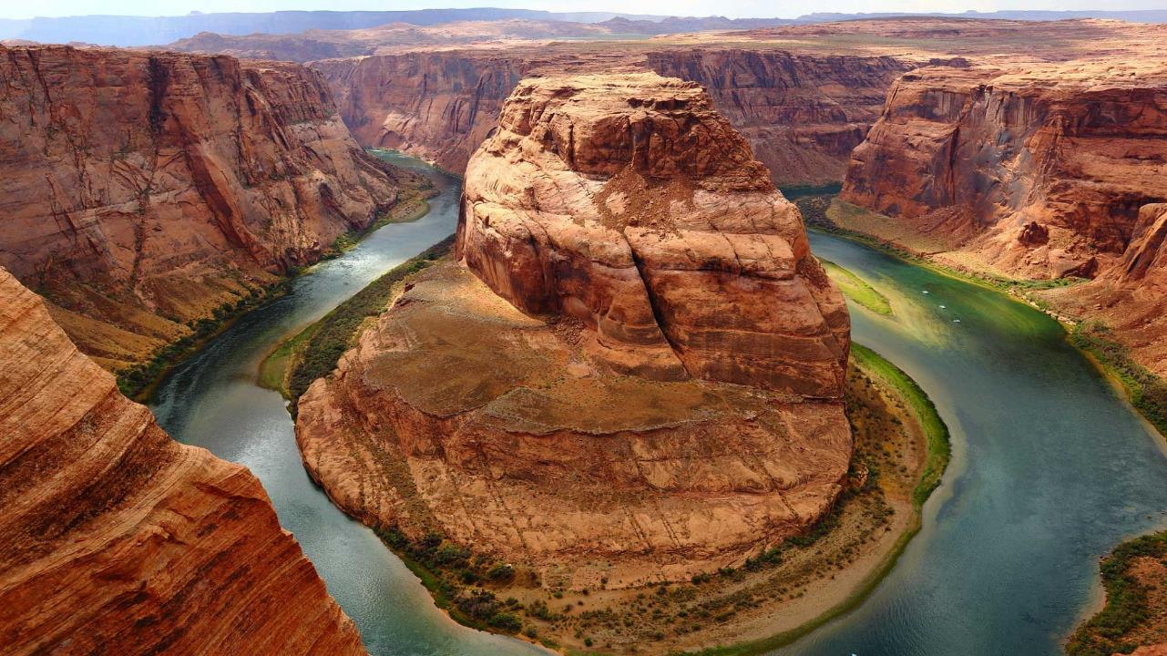
MAKANAN
Dalam Negara
N
W
E
S
Pembentangan
Individu
Bahasa Melayu 1041
Notes:
A template for students to design a field trip to a location for other students to view. Includes directions to the student of what to include on each slide and what content should be considered.

Slide 2
Pendahuluan:
Makanan?
Kebutuhan pokok
Perkembangan Zaman
Kejayaan Manusia dan fungsi Makanan
Makanan Malaysia?

Slide 3

HALAL
Certificate JAKIM
Makanan Melayu
Notes:
For example, Astoria Oregon is a town on the Oregon coast well know for its starring role in the movie “The Goonies”. Today, we will take a trip from our school to Astoria through miles and time…

Slide 4
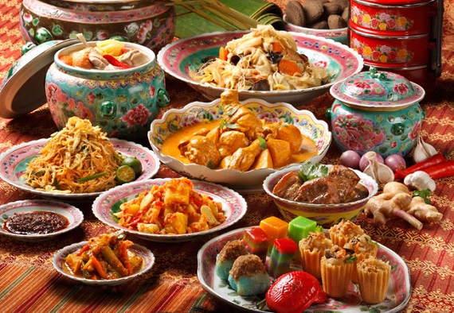
Rasa
Cita rasa makanan Melayu lagi best!

Slide 5
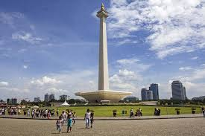
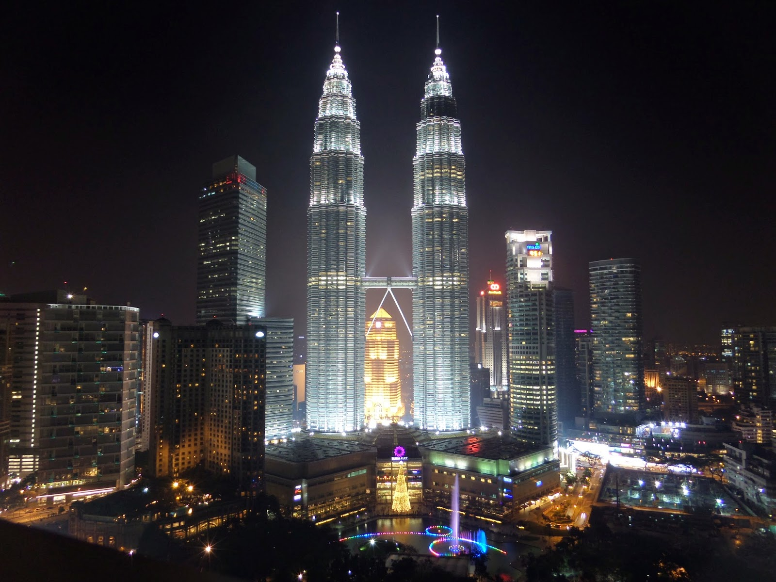
RINDU?
TIDAK MASALAH

Slide 6
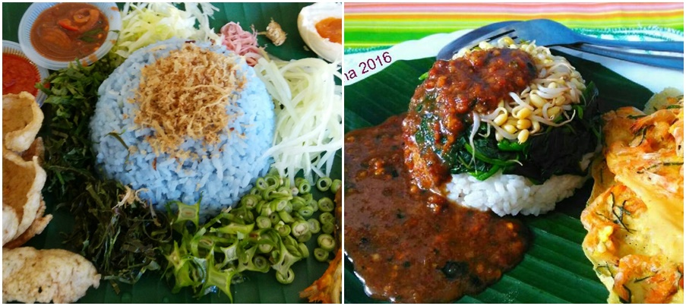
Nasi Krabu vs Nasi Pecel

Slide 7
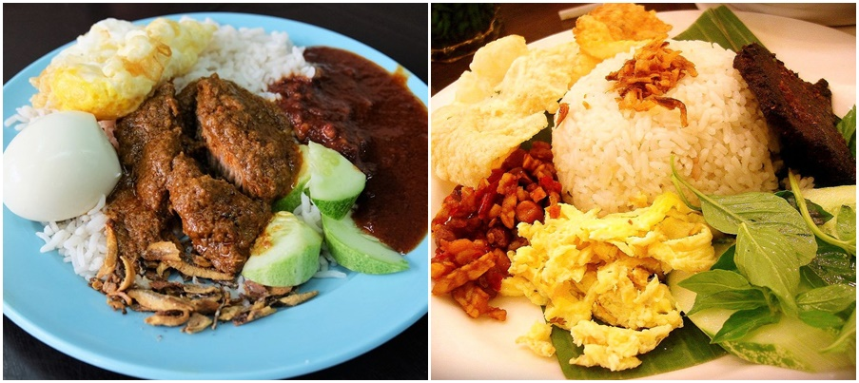
Nasi Lemak vs Nasi Uduk

Slide 8
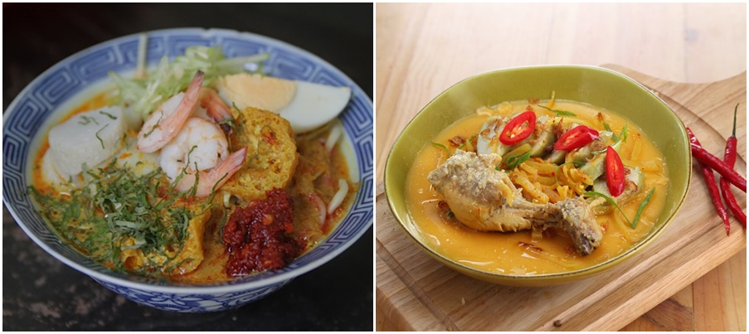
Curry Laksa vs Nasi lontong opor

Slide 9
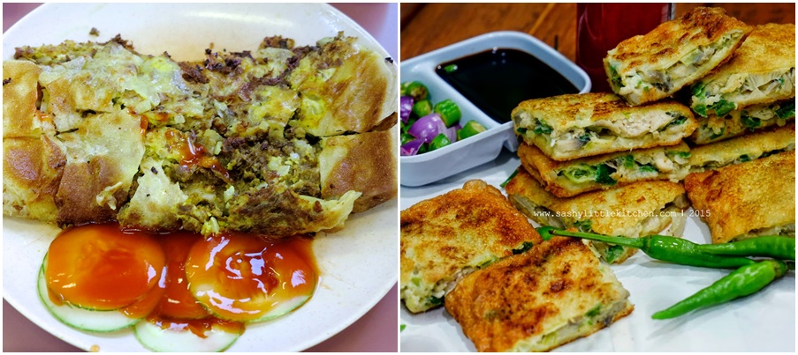
Mutton Martabak vs Martabak Telur

Slide 10
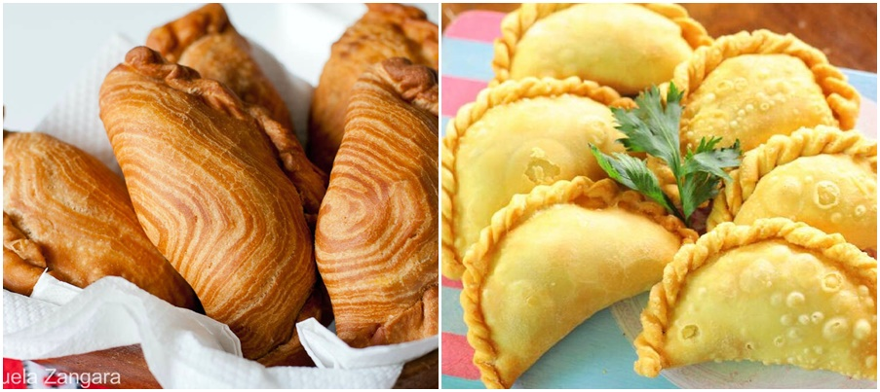
Karipap Pusing vs Pastel

Slide 11
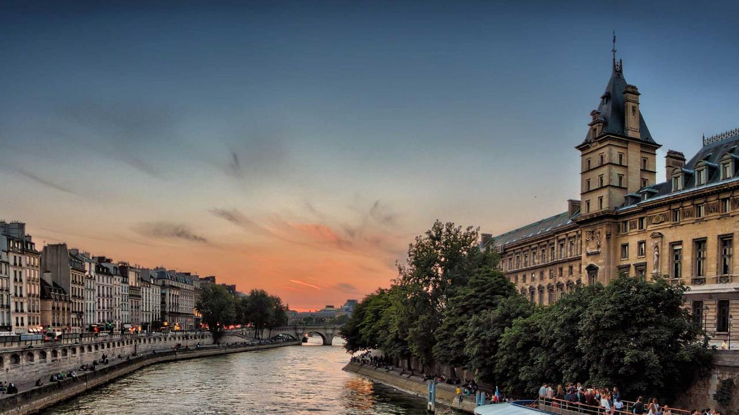
Harga??
Makanan dalam Negeri jauh
Lebih murah!

